Slide 1
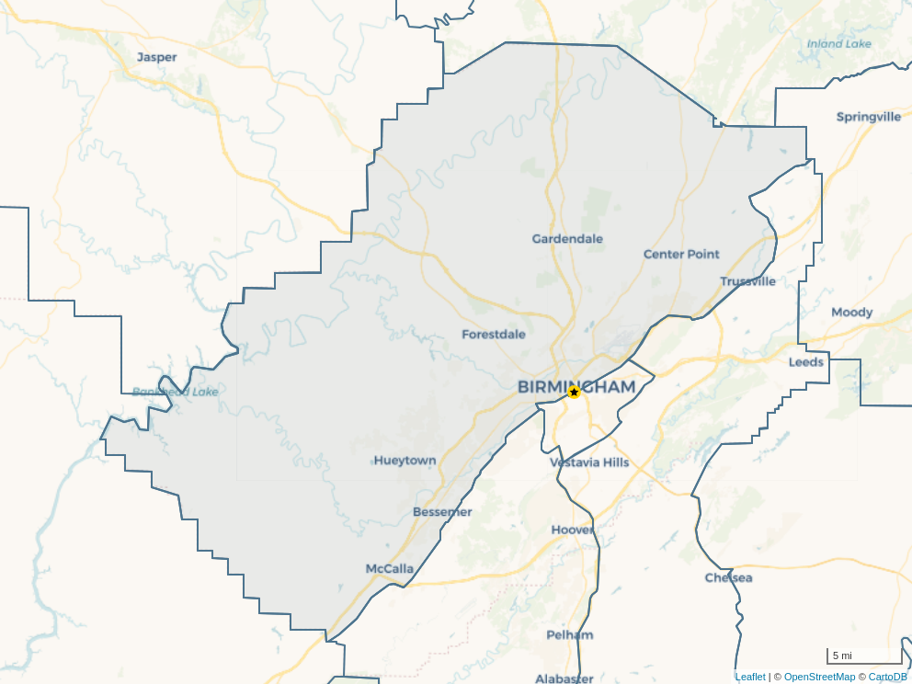
Frank, The | Frank, The
Address: | 205 20th St N
City, State, Zip: | Birmingham, AL 35203
Number Units: | 180
Year Built/Ren.: | 2023
Type: | Highrise
Special Purpose:
Amenity Class: | Above Average
Condition:
Market: | Birmingham-Hoover, AL
Submarket: | North

Slide 2
Location Analysis

Slide 3
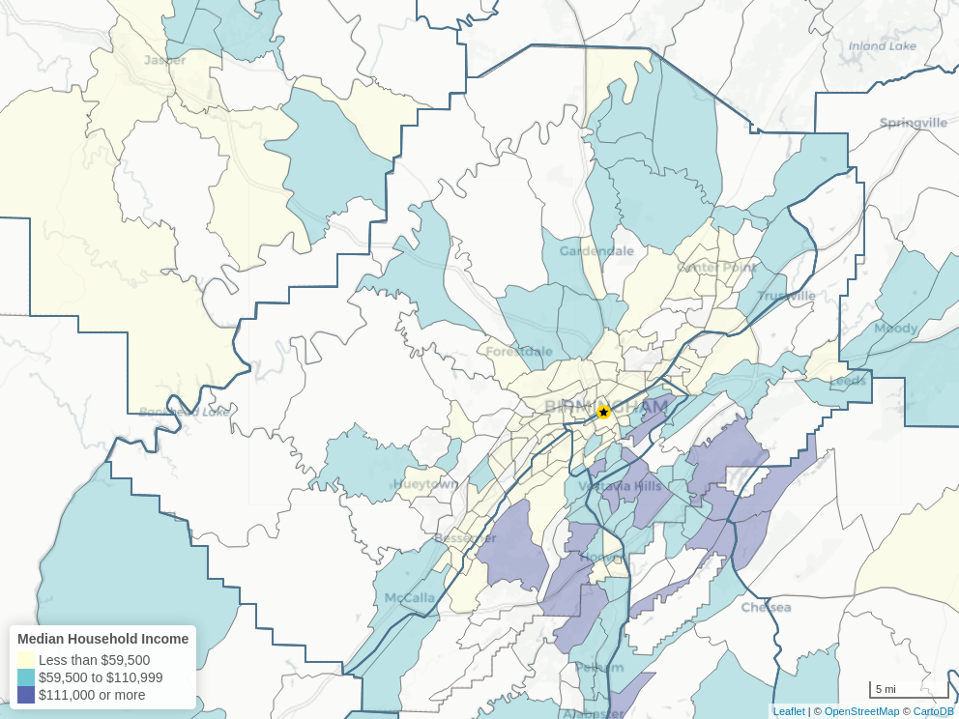
Demographics
 | Census Tract | Submarket | Market
Total Population Growth | +7.3% | -0.5% | +0.8%
% People Living in MF | 44.3% | 8.7% | 9.6%
People Living in MF Growth | +11.1% | -0.5% | -0.7%
% People with BA | 79.6% | 20.7% | 32.2%
People with BA Growth | +10.8% | +0.9% | +3.0%
% Age 20-34 | 45.0% | 17.8% | 19.6%
% Age 60+ | 7.1% | 24.2% | 23.2%
Median HH Income | $62,829 | $57,969 | $75,016
Median HH Income Growth | -1.7% | +4.7% | +6.3%
Crime Index | 5 (Severe) | 4 (High) | 3 (Elevated)

Slide 4
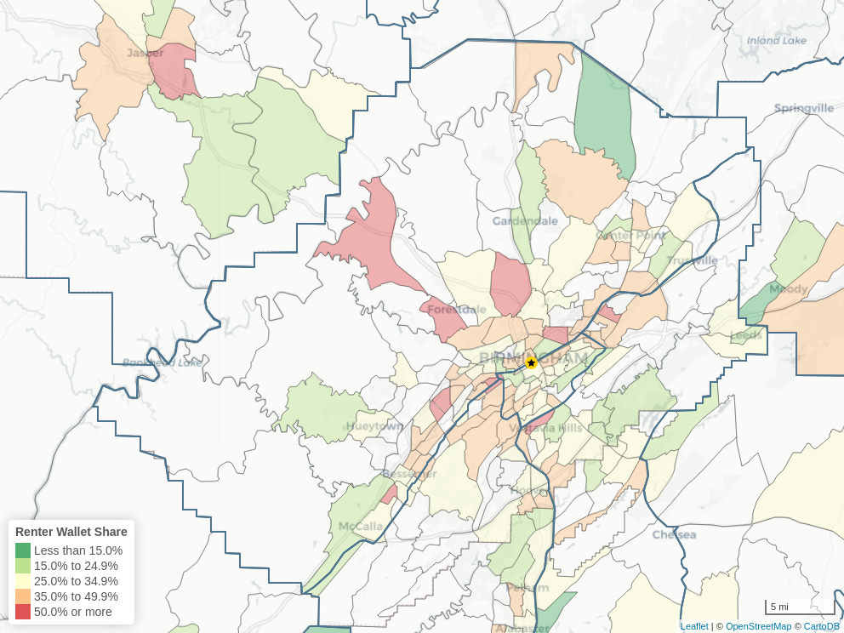
Housing Costs
 | Census Tract | Submarket | Market
Owner HH Income | $73,508 | $73,057 | $92,746
Owner HH Income Growth | +1.4% | +4.7% | +6.4%
Renter HH Income |  | $35,097 | $44,269
Renter HH Income Growth |  | +3.9% | +4.9%
Median Housing Value | $288,600 | $167,390 | $251,968
Median Housing Value Growth | +3.3% | +8.8% | +10.2%
Renter Wallet Share |  | 33.6% | 30.1%
Owning Cost Wallet Share |  | 44.0% | 42.8%

Slide 5
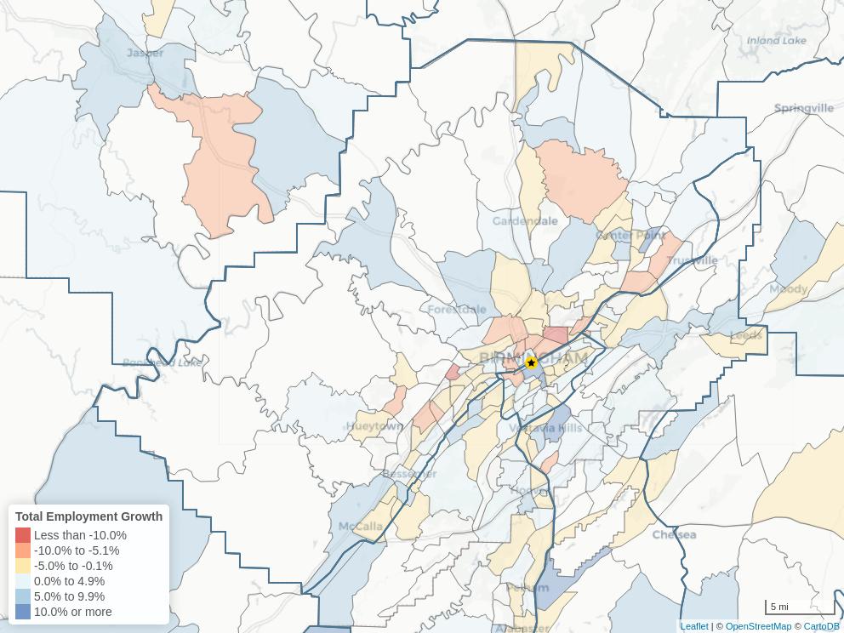
Employment
 | Census Tract | Submarket | Market
Total Employment Growth | +9.0% | -0.5% | +1.4%
White Collar % | 89.8% | 52.7% | 61.3%
White Collar Growth | +8.2% | -0.8% | +1.7%
Blue Collar % | 3.1% | 28.0% | 23.4%
Blue Collar Growth | -1.7% | +0.6% | +1.5%
Service Workers % | 7.1% | 19.3% | 15.2%
Service Workers Growth | +34.9% | -1.1% | +0.5%
Low Risk Industries % | 69.5% | 53.5% | 55.0%
Medium Risk Industries % | 14.8% | 18.1% | 18.7%
High Risk Industries % | 15.7% | 28.4% | 26.3%

Slide 6
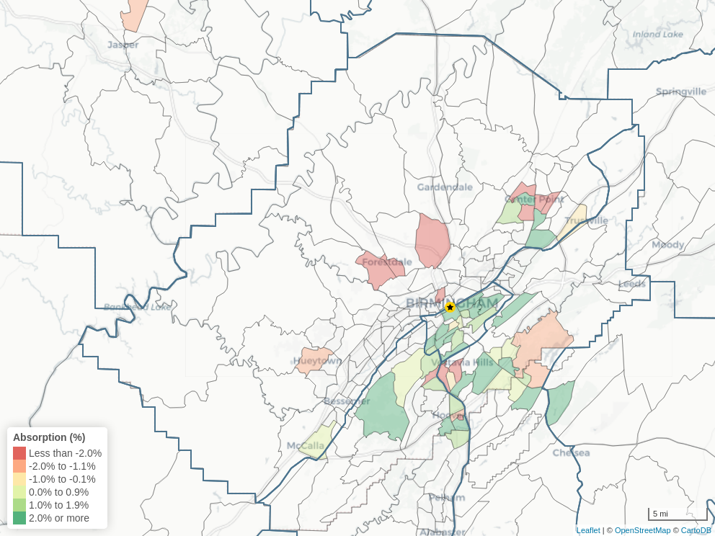
Supply & Demand
 | Submarket | Submarket | Market | Market
 | Prior | Expected | Prior | Expected
Absorption (Units) | -397 | 632 | -391 | 636
Absorption (%) | -1.6% | 0.7% | -1.6% | 0.7%
Completions (Units) | 0 | 1,730 | 303 | 1,827
Completions Over Inventory | 0.0% | 1.8% | 1.1% | 1.9%
Completions vs. Absorption | -397 | -1,098 | -694 | -1,191

Slide 7
Schools
School Name | Level | Grade Span | Distance | Report Card | Report Card | Report Card | Report Card | Report Card | Report Card
School Name | Level | Grade Span | Distance | School Performance | College Readiness | School Resources | School Discipline | District Characteristics | Final Grade
Thurston T Nelson Elementary School | Primary | PK - KG | 87.8 mi | N/A | F | A | A+ | B+ | N/A
T R Simmons Elementary School | Primary | PK - 01 | 34.2 mi | N/A | A | B | A+ | B+ | N/A
Tarrant Elementary School | Primary | PK - 02 | 4.7 mi | N/A | C | F | A+ | C- | N/A
East Elementary | Primary | PK - 03 | 4.8 mi | N/A | A+ | B | A+ | A | N/A
Midfield Elementary School | Primary | PK - 04 | 7.3 mi | F | C+ | B | A+ | C- | C
Tuggle Elementary School | Primary | PK - 05 | 1.5 mi | D+ | F | C | A+ | C- | C
Epic School | Primary | PK - 05 | 1.5 mi | A- | F | A+ | A+ | C- | B
Mountain Brook Elementary School | Primary | PK - 06 | 3.1 mi | A+ | A+ | A+ | A+ | A+ | A+
Crestline Elementary School | Primary | PK - 06 | 3.2 mi | A+ | A+ | A+ | A+ | A+ | A+
Richland Elementary | Primary | PK - 07 | 126.1 mi | B- | C | A- | A+ | B- | B
Phillips Academy | Primary | PK - 08 | 0.5 mi | A | F | C+ | A+ | C- | B-
East Franklin Junior High School | Other | PK - 09 | 75.4 mi | C- | F | A- | A | C | C
Germanshire Elementary | Other | PK - 10 | 202.3 mi | B- | F | F | A+ | C | D+

Slide 8
Market Comparables

Slide 9
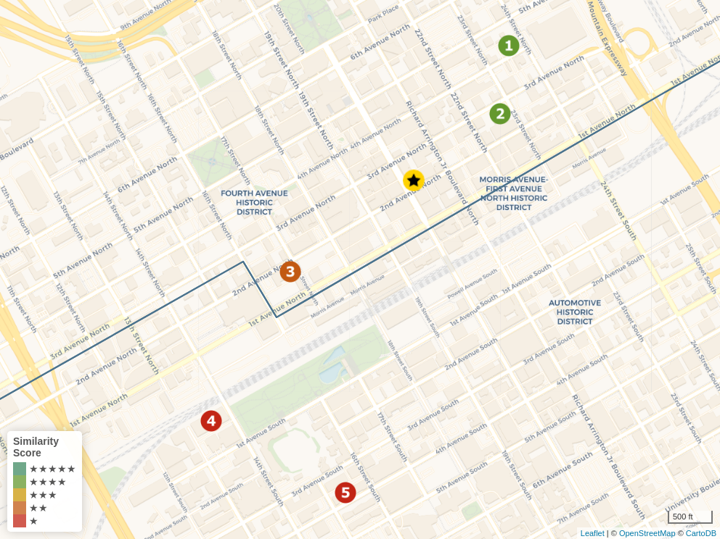
Rent Comps
★ | Frank, The 205 20th St N Birmingham, AL 35203
1. | Lofts at American Life 2308 2316 4th Avenue North Birmingham, AL 35203
2. | Market Lofts 2225 3rd Ave North Birmingham, AL 35203
3. | Thomas Jefferson Tower 1623 2nd Ave N Birmingham, AL 35203
4. | Lumen Above Railroad Park 10 14th Street S Birmingham, AL 35233
5. | Flats on Fourth 1508 4th Ave S Birmingham, AL 35233

Slide 10
Rental Comps
 | Unit Mix | Unit Mix | Unit Mix | Unit Mix
 | Studio | 1 BR | 2 BR | 3+ BR
Subject | 21.7% | 78.3% | 0.0% | 0.0%
Comps | 28.5% | 47.5% | 11.9% | 12.1%
 |  |  |  |  |  |  | Effective Rent | Effective Rent | Effective Rent | Effective Rent | Equivalent Unit Mix | Equivalent Unit Mix | Equivalent Unit Mix
 | Property Name | Distance | Amenity Class | Year Built/Ren. | Units | Occupancy | Studio | 1 BR | 2 BR | 3+ BR | Eff Rent | Rent Sq Ft | Size
★ | Frank, The |  | Above Average | 2023/2018 | 180 | 77.8% | $1,095 | $1,613 | - | - | $1,501 | $2.62 | 573
1. | Lofts at American Life | 0.35 mi | Above Average | 2020 | 140 | 87.9% | $1,018 | $1,003 | $1,450 | - | $1,006 | $2.41 | 417
2. | Market Lofts | 0.23 mi | Above Average | 2023 | 192 | 99.5% | $947 | $982 | $2,421 | - | $974 | $2.09 | 466
3. | Thomas Jefferson Tower | 0.32 mi | Luxury | 2017 | 96 | 94.8% | - | $1,119 | $1,738 | - | $1,119 | $1.54 | 725
4. | Lumen Above Railroad Park | 0.66 mi | Luxury | 2021/1944 | 200 | - | $1,214 | $1,315 | $2,065 | $2,864 | $1,293 | $2.36 | 548
5. | Flats on Fourth | 0.67 mi | Above Average | 2017 | 86 | 95.3% | $1,216 | $1,559 | $2,251 | - | $1,485 | $2.21 | 672
 | Comp Average* |  |  |  | 714 | 94.8% | $1,031 | $1,086 | $1,935 | $2,864 | $1,076 | $2.17 | 506

Slide 11
Rent History

Slide 12
Occupancy History

Slide 13
Expense Comps
 | Average Market
# of Props | 70
OpEx Ratio | 54.1%
Taxes | $1,305
Insurance | $733
Utilities | $1,567
Rep & Maint | $978
Mgmt Fees | $496
Payroll | $1,516
Adv & Mark | $153
Prof Fees | $59
Gen Admin | $622
Ground Rent | $0
Other | $17
Total | $7,446
Controllable | $3,841

Slide 14





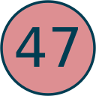




Deal Analysis

Slide 15
Terms & Definitions
Comps
Rent – the map shows the rent comps that were selected for the subject property, with the pin color reflecting the similarity of that comp to the subject. A similarity score of 1 (in red) represents a low level of similarity and 5 (in green) represent a high level of similarity.
Expense – comps are broken out into 4 groups based on their controllable expenses. The 1st Quartile is the average of the most efficiently operated properties, while the 4th Quartile is the average of the least efficient.
Housing Costs
Renter Wallet Share – gross rent (asking rent plus utilities) as a percent of renter household income. Based on data from the ACS.
Owning Cost Wallet Share – annual owner costs (which could include mortgage payments, deeds, debt, taxes, utilities, condo fee, etc.) as a percent of renter household income. Based on data from the ACS.
Employment
Total Employment, White Collar, Blue Collar, and Service Worker Growth – reflects the percent change in the number of employed residents in that geographic area and category, 3-year CAGR.
High, Medium, and Low Risk industries – risk level based on historic job growth and the impact and recovery of prior economic shocks such as the COVID-19 pandemic, the 2008 housing crisis, and the 2001 tech bubble.
Supply & Demand
Absorption – the change in the number of occupied multifamily units over the specified period, in units or percent. Expected absorption assumes the same % change as the prior 12-month period.
Prior Completions – the number of new construction units completed over the last 12 months.
Expected Completions – the number of new construction units expected to be completed over the next 12 months.

Slide 16
Terms & Definitions
Property Performance
Rent Below Comps – assesses the opportunity to increase rents by comparing the effective rent of the subject property to the most similar properties around it.
Occupancy Above Market – compares the current occupancy of the subject property to the overall market occupancy rate.
Low Volatility – analyzes the last 2 years of rent growth and occupancy for the subject property against comps. The property is considered "volatile" if rent growth lags more than 3% behind comps or drops below 0%, or if occupancy is 5% lower than comps or falls below 85%.
Expenses Above Comps – assesses the opportunity to decrease operating expenses by comparing the subject property to the most similar properties around it (limited to those with available expense data).
Area Characteristics
Location Demand – measures the tenant desirability of the subject property's location (census tract) relative to the rest of the market. Considers crime, schools, household income, housing values, employment growth, and proximity to grocery stores and pharmacies.
Luxury Demand – measures the desirability of the subject property's location (census tract) for luxury tenants specifically. Considers, percent and growth of white-collar workers, residents with a BA+, and renter household income.
Low Renter Wallet Share – this metric compares the renter wallet share of the subject property's location (census tract) to the rest of the market and is leveraged in the value-add and distressed strategies when assessing the viability of pushing rents.
Crime Index – this metric compares the relative risk of crime at the subject property's location (census tract) to the nation. The Crime Index is a 1 to 5 scale:
1 (Low): less than half the national average; 2 (Moderate): half the national average to slightly above the national average; 3 (Elevated): slightly above national average to twice the national average; 4 (High): twice the national average to three times the national average; 5 (Severe): more than 3 times the national average.
Census Tracts
Small, semi-permanent statistical areas created by the U.S. Census. Population size generally ranges between 1,200 and 8,000 people, with an optimum of 4,000 people. Spatial size varies on population density. Boundary lines always respect county and state borders and often follow visible or identifiable features, as well as nonvisible legal boundaries. (see more at: https://www.census.gov/programs-surveys/geography/about/glossary.html)

Slide 17
Terms & Definitions
Property Strategy
New Construction – Currently limited to properties already in the pipeline, this strategy focuses on the viability of the location to support luxury rents and prefers properties having similarly situated rent comps.
Organic Growth – This strategy does not expect planned improvements and looks for properties with strong performance situated in areas that support natural rent growth. There is significant preference placed on properties having high occupancy, rent at or below comps, and stable historical performance.
Value-Add – This strategy is seeking a stable property having low rents relative to comps, along with nearby renovated properties achieving significantly higher rent. Roughly a third of the score is based on area characteristics that would support increased rents.
Distressed – While assuming it will ultimately be a value-add project, this strategy is specifically targeting properties that are experiencing low performance relative to comps and high volatility. A preference is placed on properties having area characteristics that would support increased rents.
Affordable – This strategy looks for stable properties flagged as affordable housing, or with rents less than 30% of 80% of AMI
Market Strategy
Core/Primary – This strategy is looking for high performance submarkets within the top 40 markets, strongly preferring the top 20. It emphasizes growth in income, housing values, and rents, while looking for strong occupancy and high cost of homeownership. While not too concerned about new supply in the overall market, it heavily prefers submarkets where the increase in demand has outpaced new supply.
Emerging – This strategy is searching for the next up and coming market, targeting smaller markets with high demand, higher cap rates, and outpacing growth metrics such as population, income, housing values, and rents. This strategy focuses on overall market performance rather than the specific submarket.
Resilient – With a greater emphasis on stability than growth, this strategy is focused on strong employment and balanced supply and demand. It's looking for strong fundamentals and puts no preference on market size or cap rates.
Opportunistic – This strategy is looking for the best performing submarkets at the highest cap rates. Largely ignoring overall market metrics, it focuses almost exclusively on the submarket and finding that "diamond in the rough."
Expense Reduction Strategy
The opportunity to reduce expenses is determined by comparing the subject property's expenses to comps. If available, the analysis compares controllable or total expenses per unit to the comp set, otherwise the property is assumed to be operating in line with the comp median.

Slide 18
The data and other information contained herein (together with all presentation methodologies, the "Information") is for informational purposes only and is not intended as investment advice nor as an offer or solicitation for the purchase or sale of any real property and/or to adopt any particular investment strategy. Any projections, opinions, assumptions or estimates contained herein are for illustrative purposes only and do not represent past, current or future performance of any property. Berkadia has not made (nor will it make) any investigation of the accuracy or completeness of any Information. It is your responsibility to do so. Consequently, Berkadia makes no warranties or representations whatsoever (either expressed or implied) regarding the accuracy or completeness of any Information and in no event shall Berkadia or any of its affiliates be liable for any use by any party of, for any decision made or action taken by any party in reliance upon, or for any inaccuracies or errors in, or omissions from, any and all Information. All users accessing this application must make their own decisions regarding the use of any Information and must not rely upon such Information in evaluating the merits of any decisions made with respect thereto.

